Slide 1


Slide 2


Slide 3
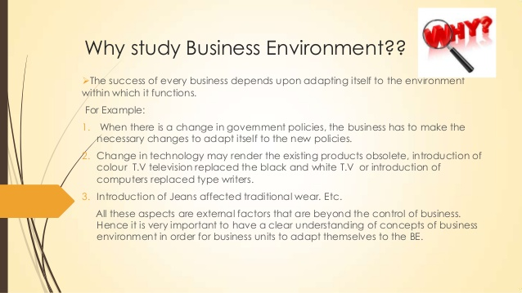

Slide 4
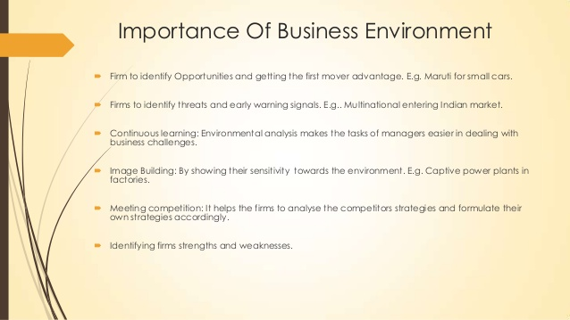

Slide 5
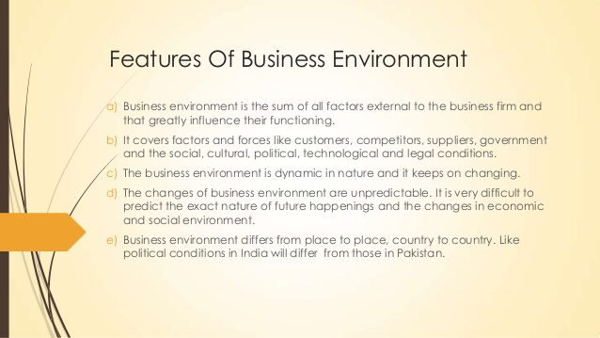

Slide 6
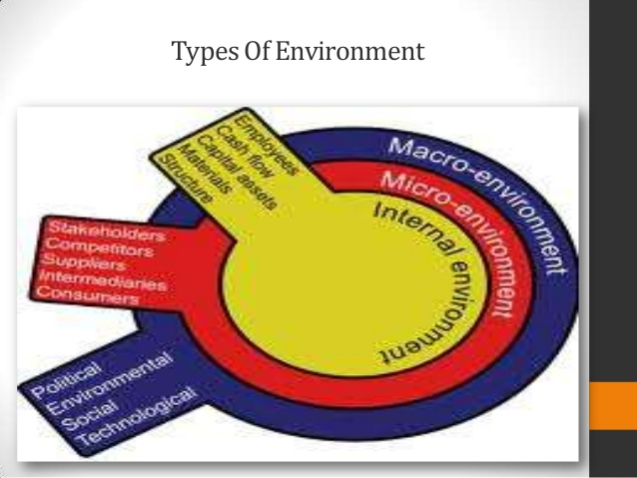

Slide 7
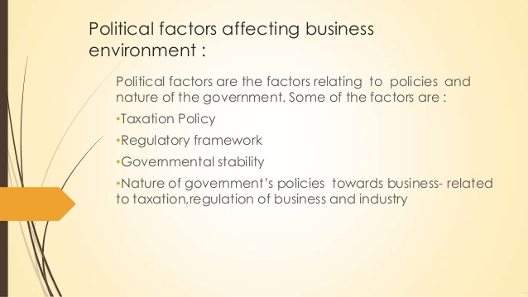

Slide 8
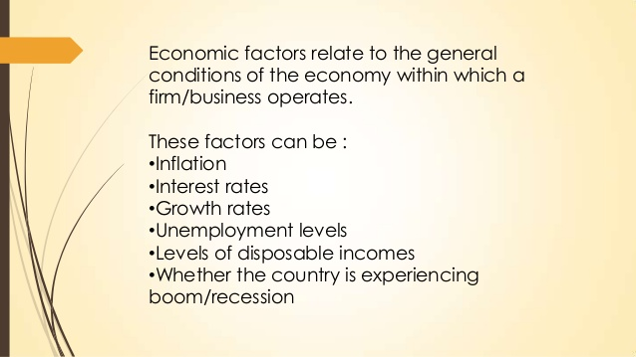

Slide 9
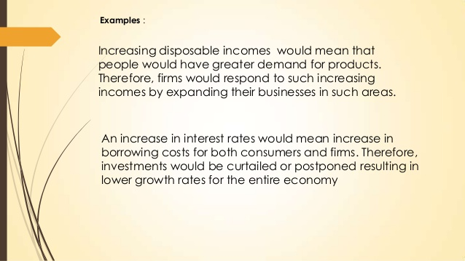

Slide 10
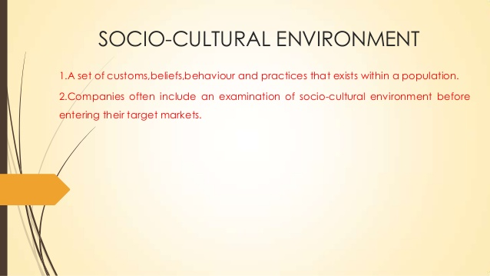

Slide 11
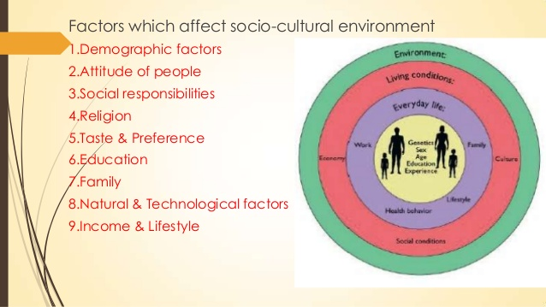

Slide 12


Slide 13
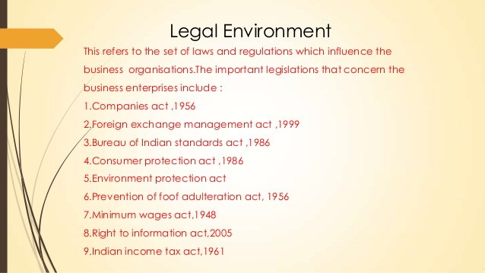

Slide 14
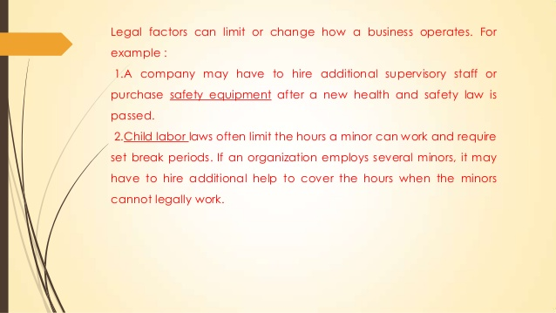

Slide 15
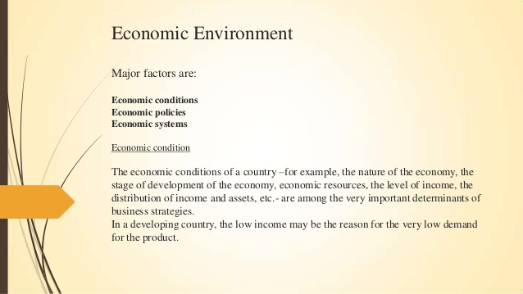

Slide 16
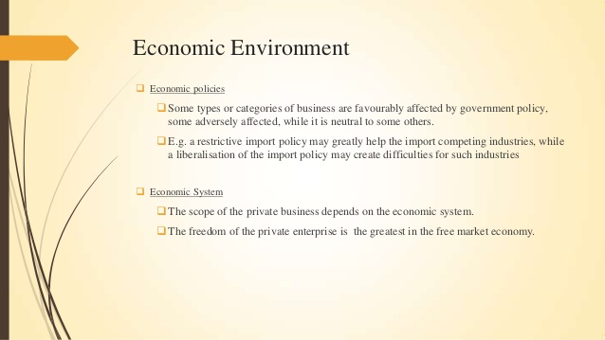

Slide 17
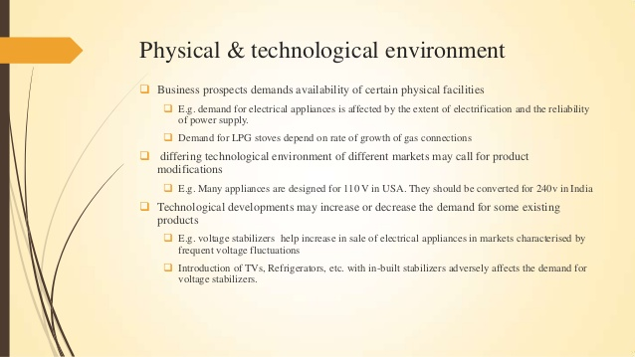

Slide 18
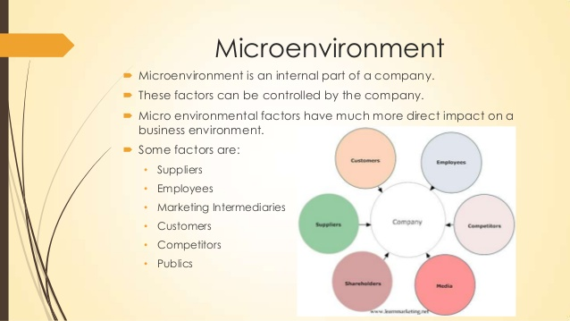

Slide 19
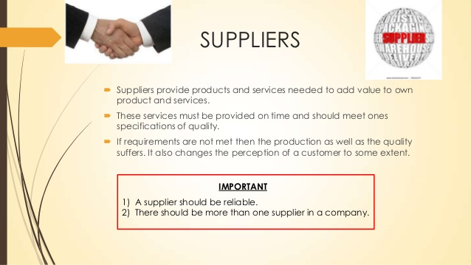

Slide 20
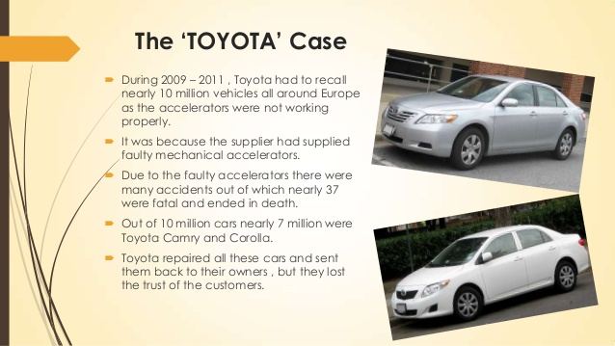

Slide 21


Slide 22


Slide 23
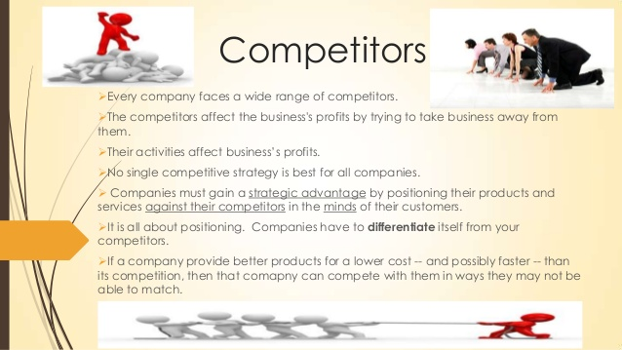

Slide 24


Slide 25
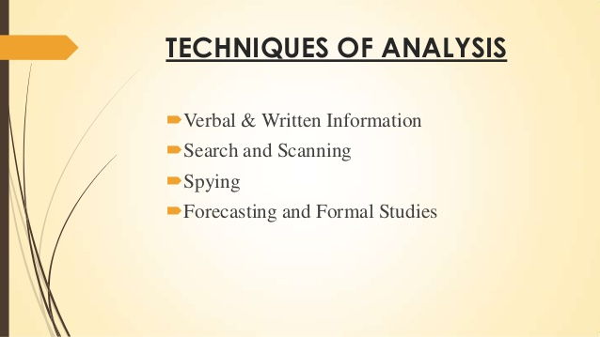

Slide 26
Environmental analysis process
Environment analysis is managerial decision making based on the assessment of opportunities and threats in the environment. The step in environmental analysis are : 1)Scanning :It involves information gathering for assessing the nature of the environment in terms of uncertainly, complexity and dynamism it :
Identifies early signs of future environmental changes.They are indicated by trends and events.
Detects changes already underway.They are happening.
2)Monitoring :It involves tracking environmental trends and events.It is auditing of environment.The likely impact of environmental influences on business performance are identified.

Slide 27
contd
3)Forecasting :This step forecast what is likely to happen.It lays out of path for anticipated changes. This step provides:
Key force at work in the environment.They can be politicalegal,economic,social cultural,technological.
Understanding of the nature of key influences and drivers of change.
Projection of future alternative paths available.
4)assessment :This step identifies key opportunities and threats.The competitive position of business analyzed in terms of how the organization stands in relation to other organizations.competing for some resources of customers.
Opportunities is a favorable condition which creates risks and weakens the competitive position.
Threat is an unfavourable condition which strengthens organization's competitive position of the organization.

Slide 28
Contd..
Environmental analysis identifies competitive position of a business organization. Factors affecting the competitive position are :
Competitors :Current and positional competitive and their objectives and strategics.
Strategic groups:Other firms in the industry following similar competitive approaches.
Market factors :Customer needs,market segments,market power,market share and growth.
Market attractiveness :The degree of market attractiveness for the products.

Slide 29
ENVIROMENTAL ANNALYSIS

Slide 30
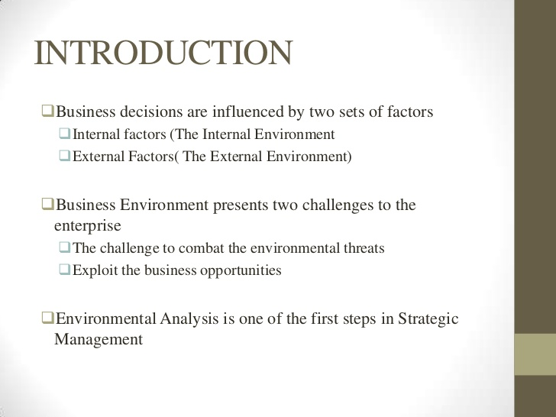

Slide 31
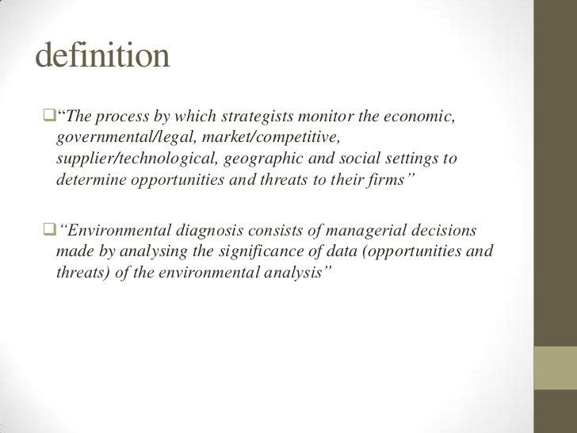

Slide 32
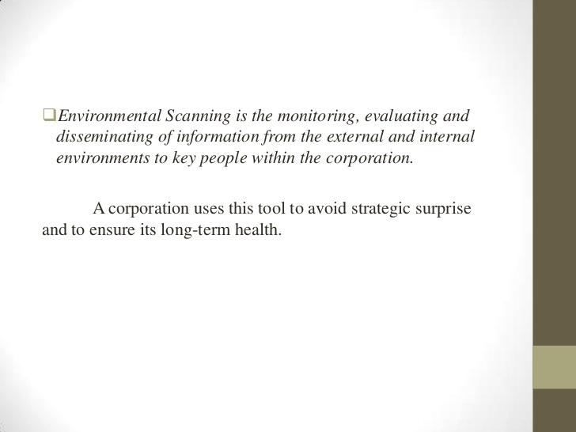

Slide 33
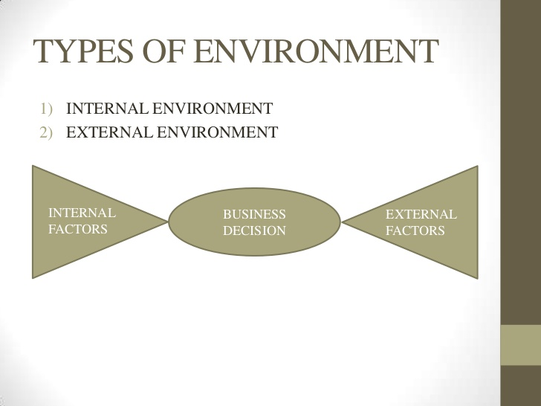

Slide 34
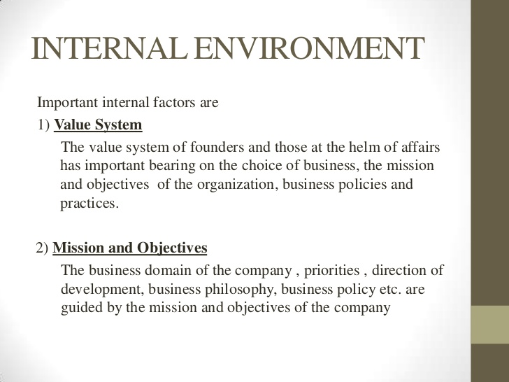

Slide 35
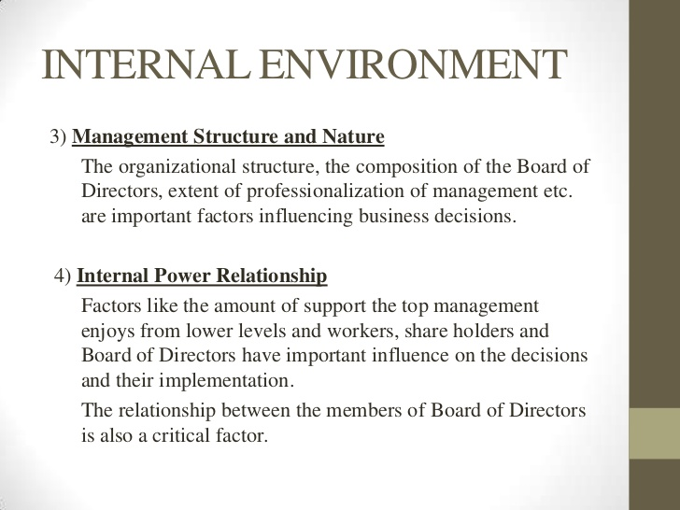

Slide 36
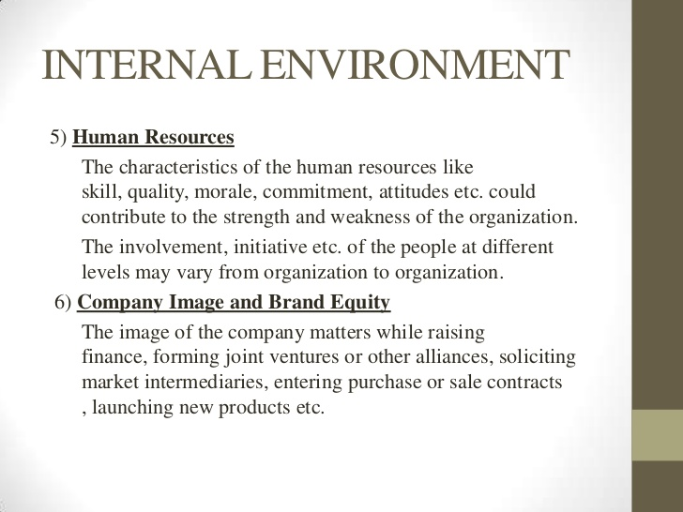

Slide 37
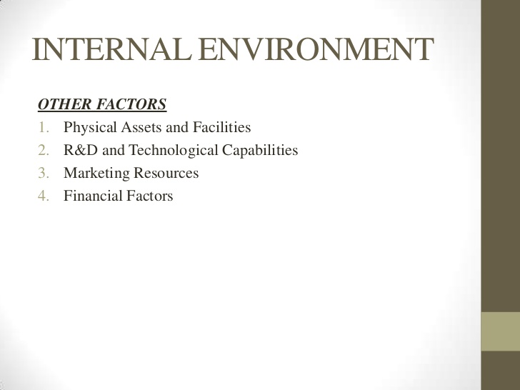

Slide 38
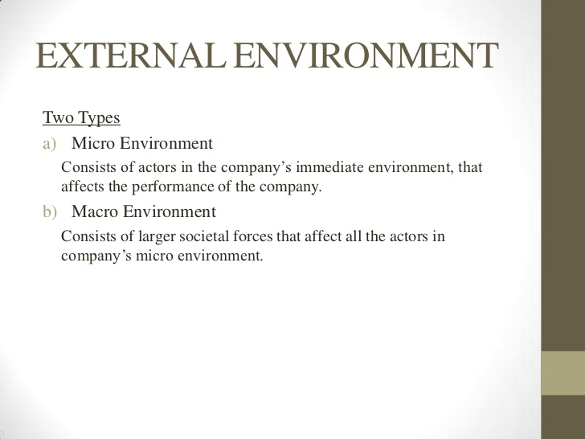

Slide 39
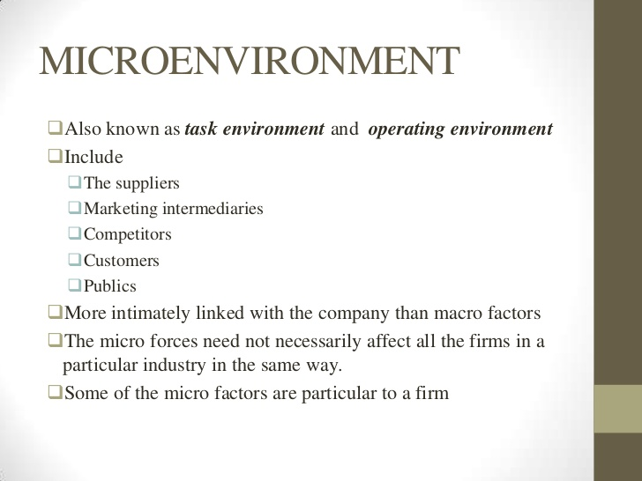

Slide 40
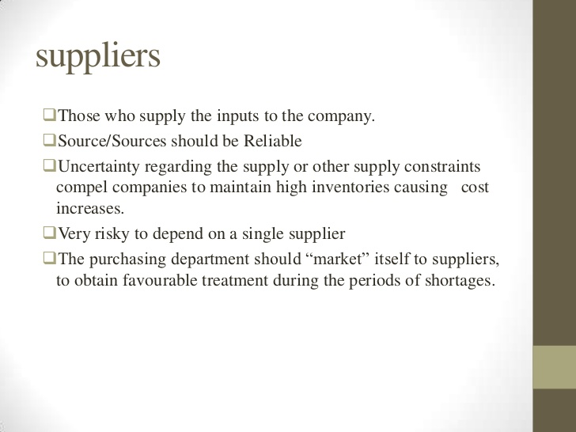

Slide 41
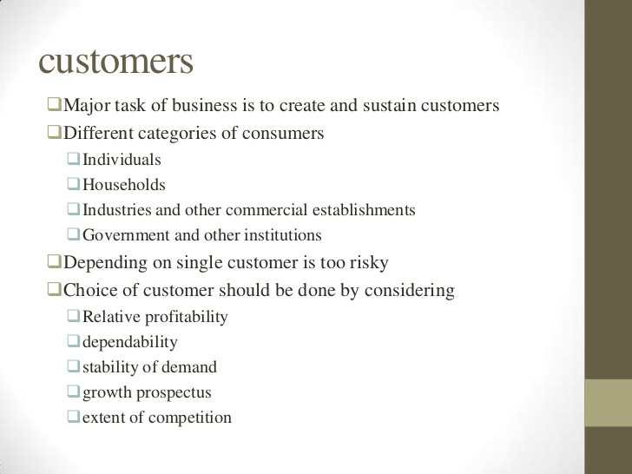

Slide 42
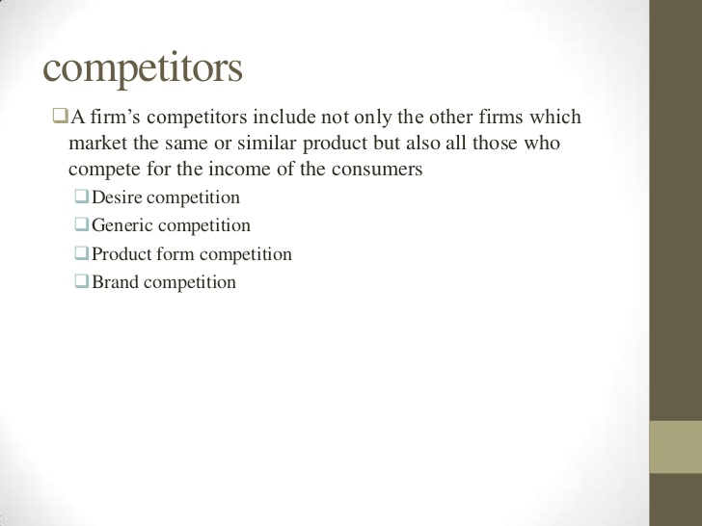

Slide 43
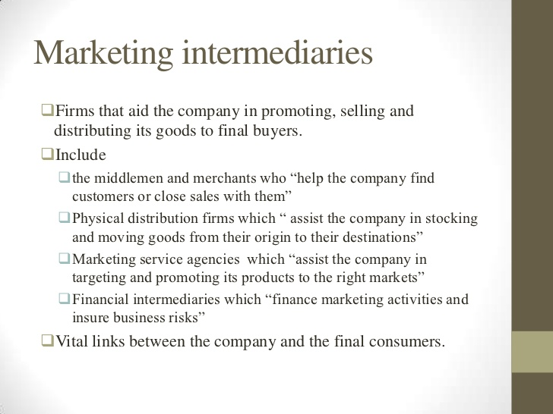

Slide 44
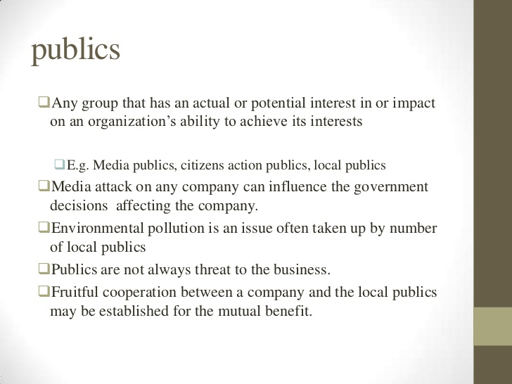

Slide 45
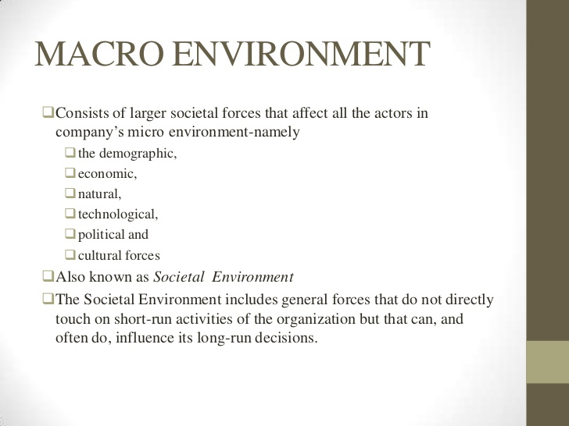

Slide 46
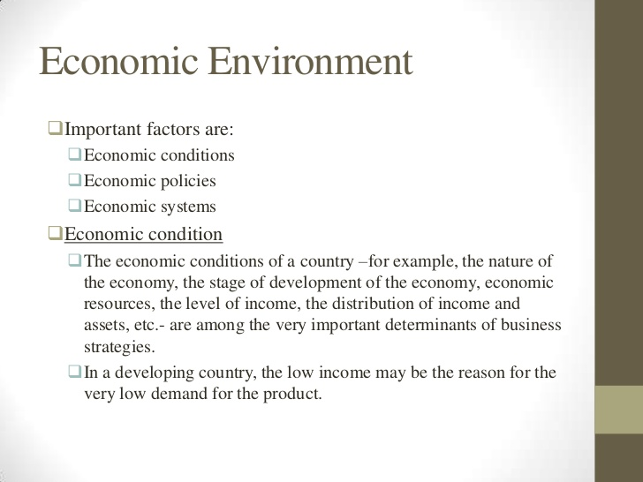

Slide 47
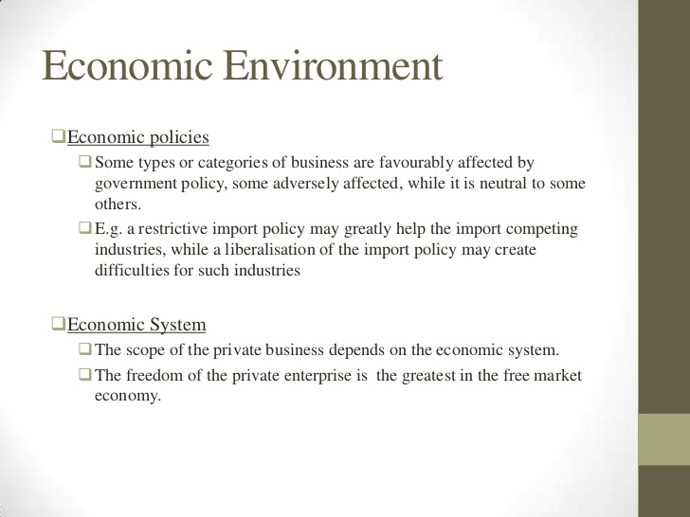

Slide 48
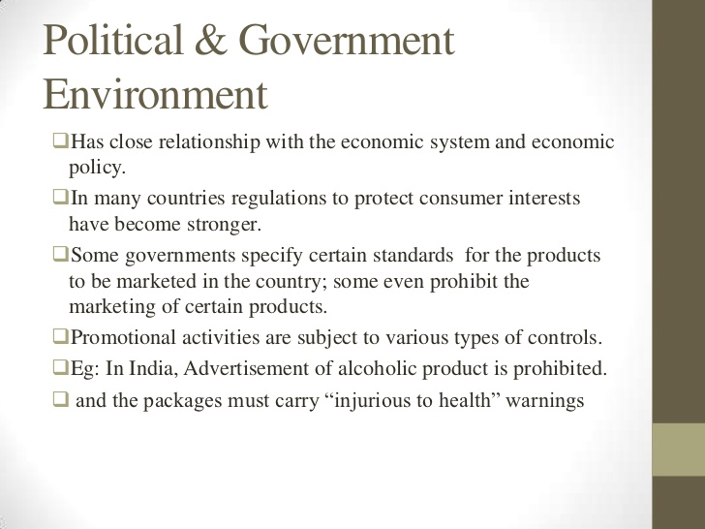

Slide 49
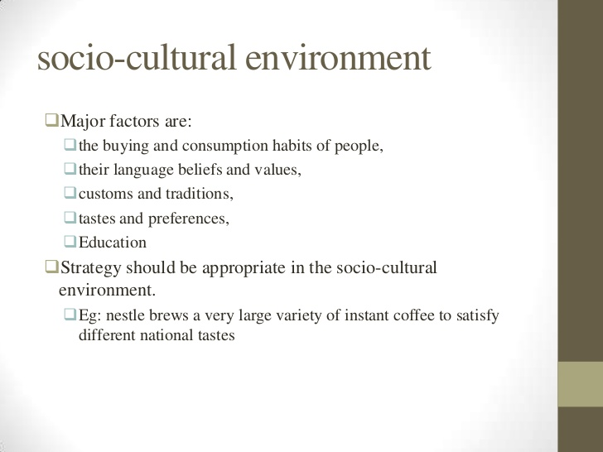

Slide 50
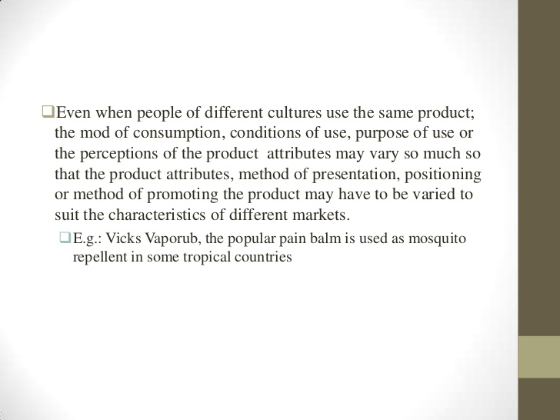

Slide 51
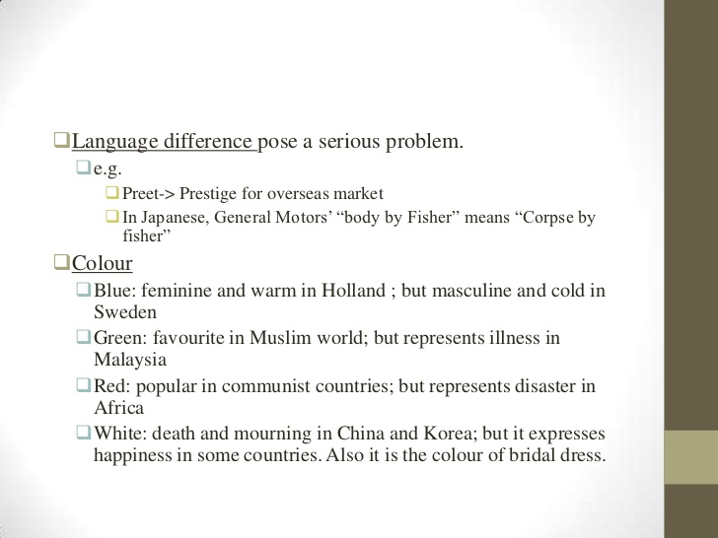

Slide 52
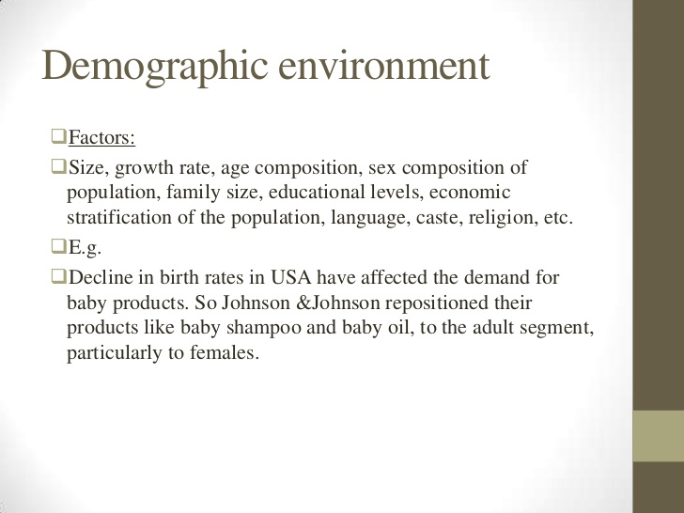

Slide 53
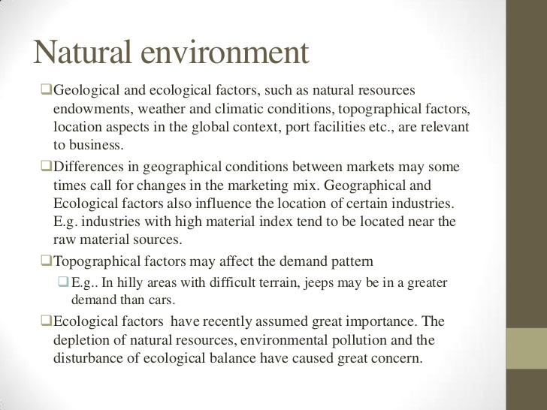

Slide 54
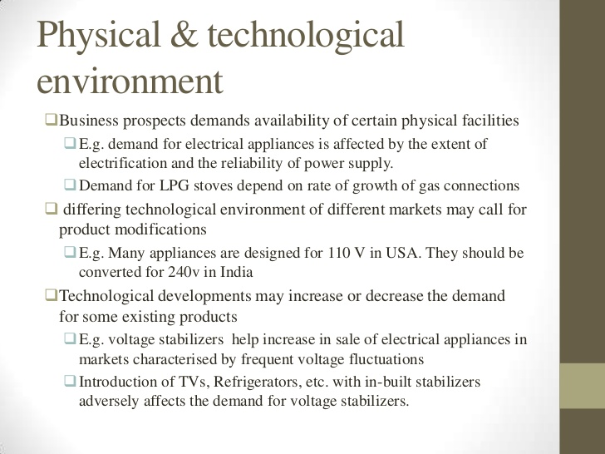

Slide 55
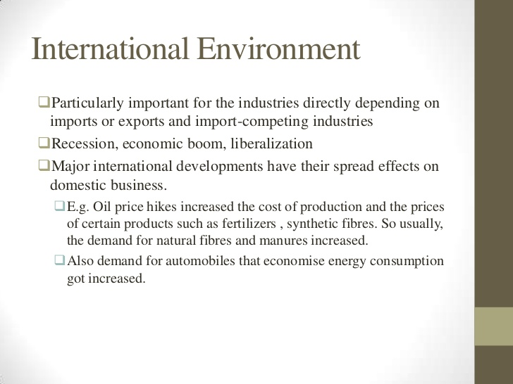

Slide 56
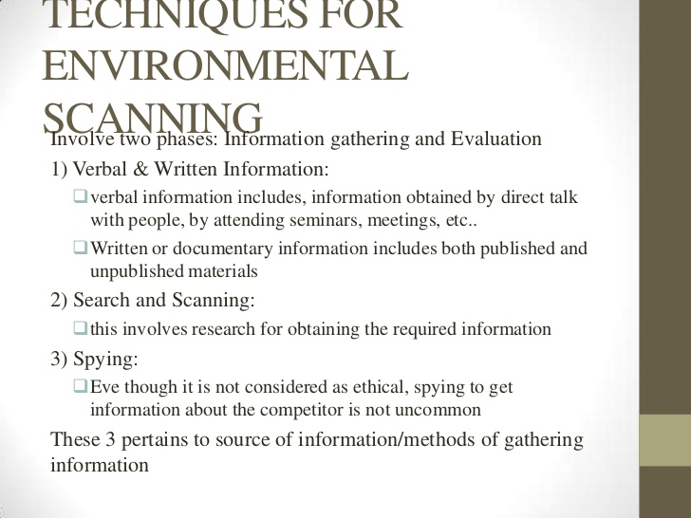

Slide 57
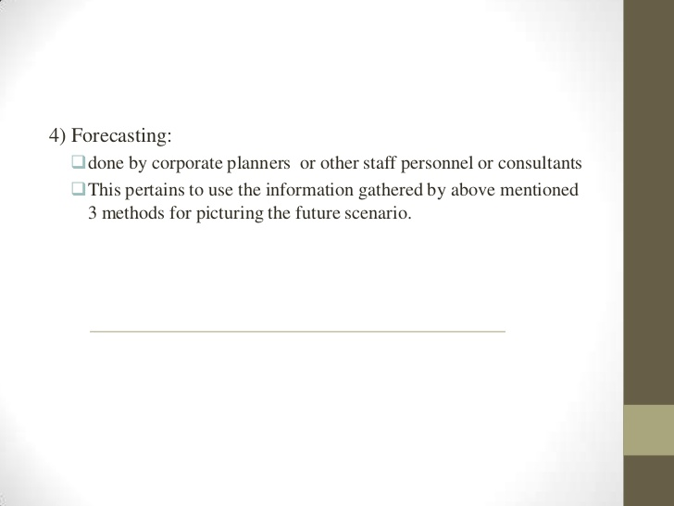

Slide 58
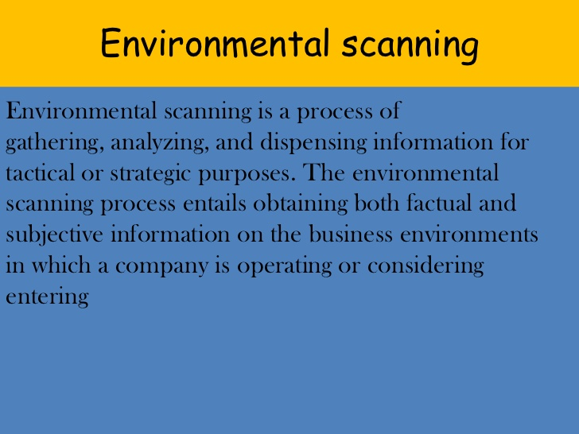

Slide 59
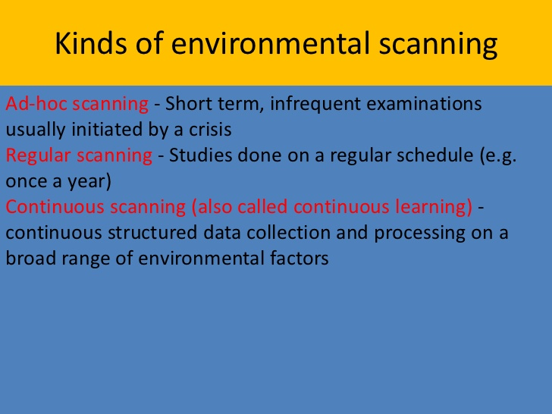

Slide 60
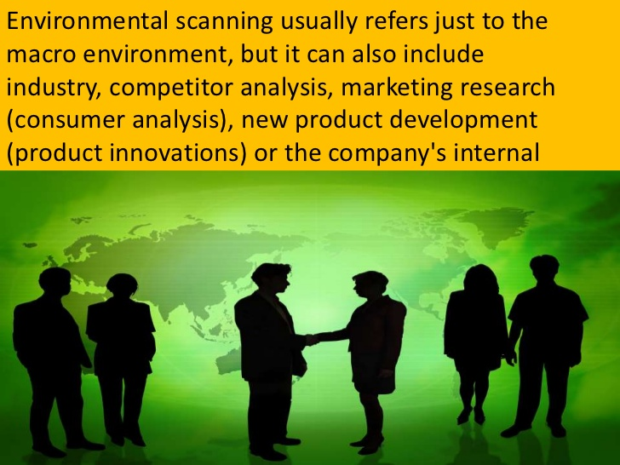

Slide 61


Slide 62


Slide 63


Slide 64
Use of environmental analysis in strategic management
strategic management process involves
Goal formulation
SWOT analysis
Identification of strategic alternatives
Strategy formulation
Strategy implementation
Measurement and evaluation
Reformulation of strategy

Slide 65
Use of environmental analysis in strategic management
Reducing the impact of environmental forces
Creating an organizational structure and control system.
Boundary-Spanning Roles.

Slide 66


